Slide 1

Water Safety
and Alcohol

Slide 2
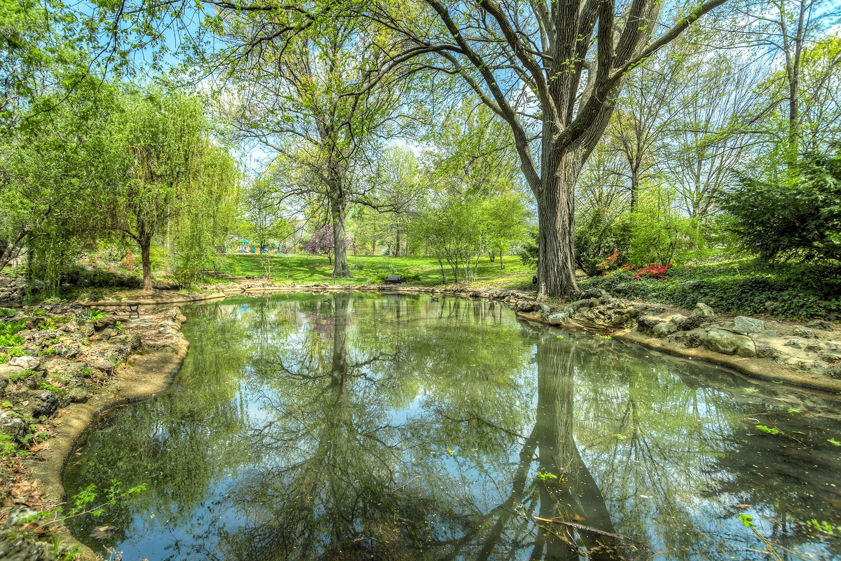
Starter activity
Can you think of somewhere local that is similar to this photo?
What sort of activities can you do there?

Slide 3
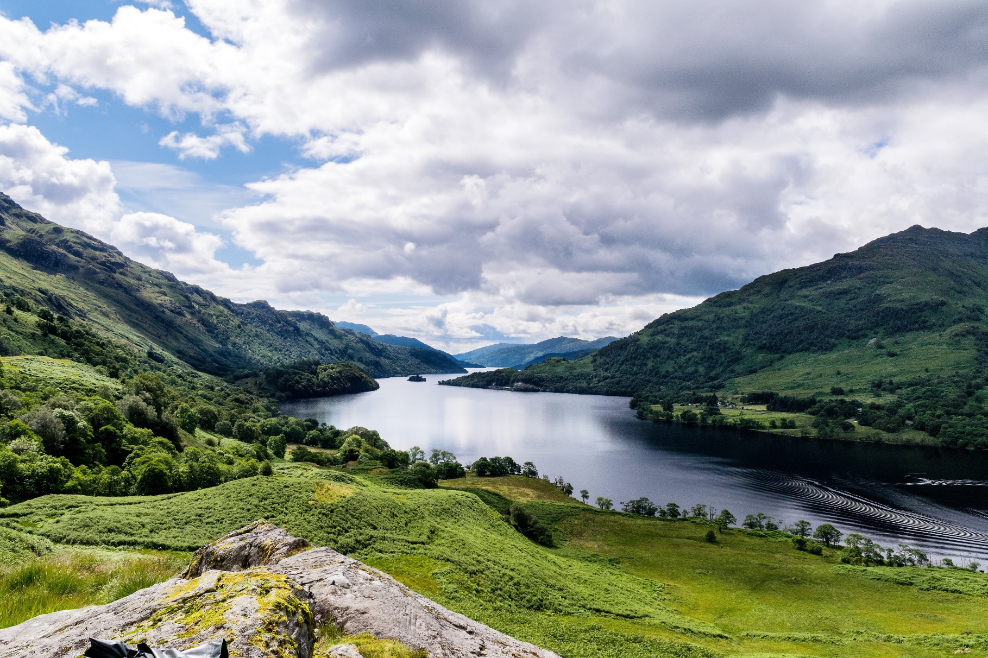
Learning objectives
Objectives:
To develop an understanding
of the dangers of alcohol around water.
To develop an understanding of how you can keep yourself and others safe around water,
and how to respond in an emergency.

Slide 4
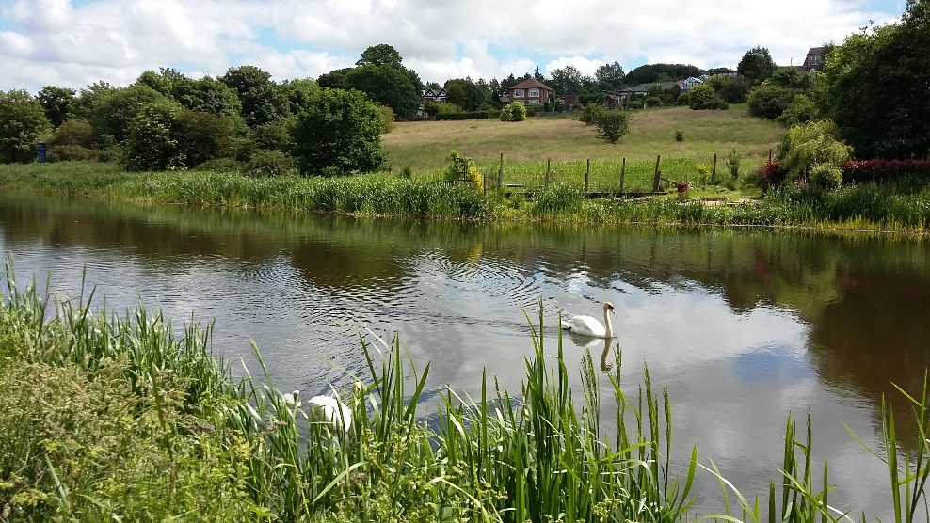
Activity 1 Stop and Think, Spot the Dangers
Imagine you and a few friends are hanging out after school by a canal
It’s important to Stop and Think, Spot the Dangers
when you’re near water.
Can you see any dangers in this picture?
What dangers might be hidden?
It’s important to identify where you are and if there is rescue equipment near you. How could you get help if you got into trouble here?
What type of information might be near water to help warn you of potential dangers?

Slide 5
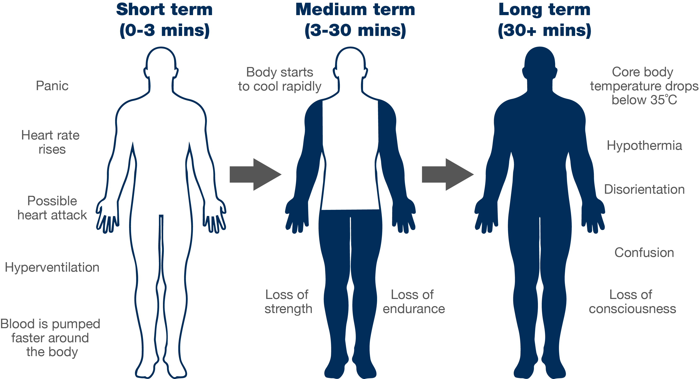
Cold water shock

Slide 6

Activity 2
It’s important to Stop and Think,
Spot the Dangers when you’re near water.
What additional dangers might alcohol bring to this scenario?
How might alcohol increase the effects of Cold Water Shock?
Do you think there could be a delay to the emergency response?
Note: Scotland data only 2017 – 2021, WAID

Slide 7
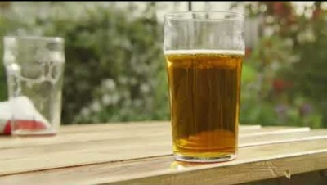

Slide 8
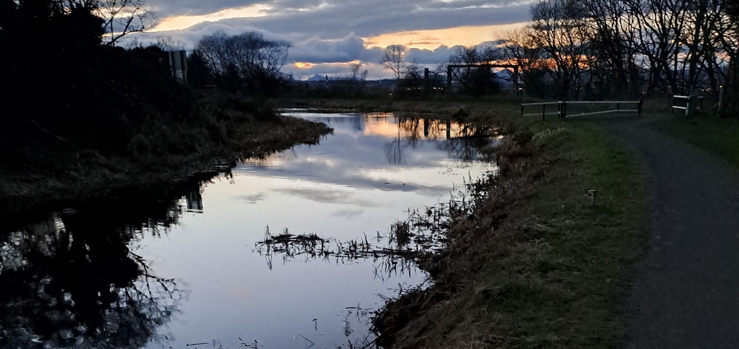
Activity 3
What additional dangers might alcohol bring to this scenario?
Why is it safer to be in a group?

Slide 9
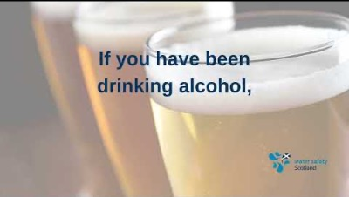

Slide 10
Activity 4
Have you learned the Water Safety Code?
Think of that same body of water again.
Not all dangers are visible: think of two that you can’t always see.
What two actions should you take if you see someone in trouble in the water?
What should you do if you find yourself in water unexpectedly?
How would you challenge dangerous behaviour you see?

Slide 12


