Slide 1

Water Safety Workshop

Slide 2
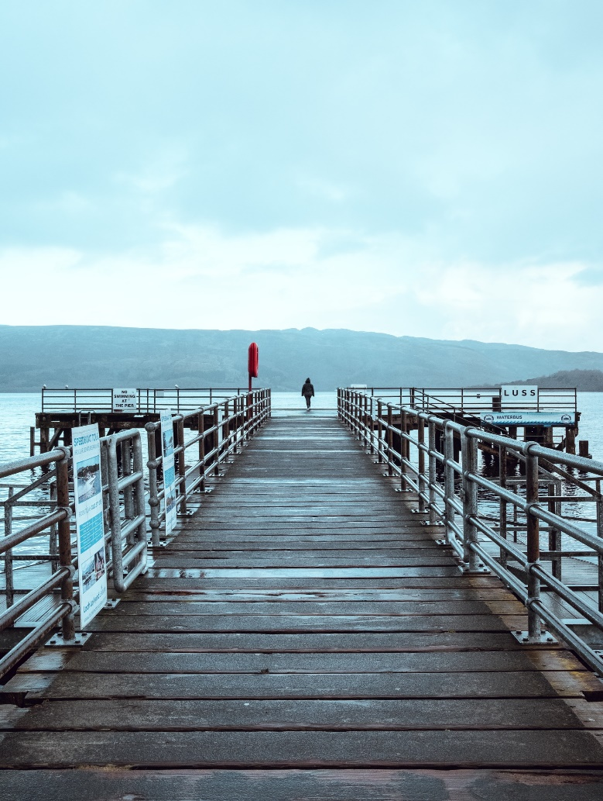
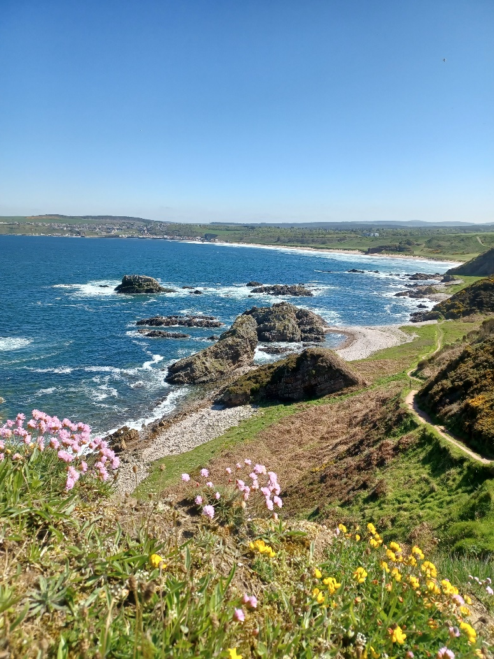
Starter activity
Think of a body of water near you – it could be a river, loch or beach.
What do you do there?
Not all risks are easy to see which can be very dangerous.
Can you think of any?
Notes:
Starter Activity: Think of a body of water near you – it could be a river, loch or beach What do you do there?
Challenge question: not all risks are easy to see which can be very dangerous. Can you think of any?

Slide 3
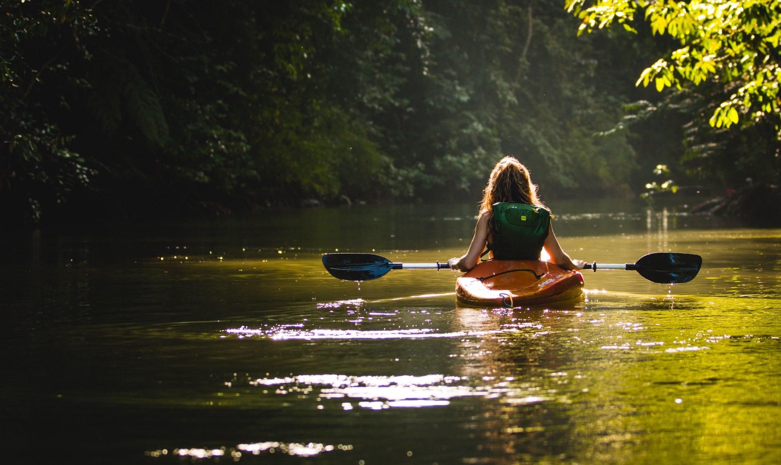
Learning objectives
To develop an understanding of the dangers of water, in particular the effects of cold water shock.
​
To develop an understanding of how you can keep yourself and others safe around water, and how to respond in an emergency.
Notes:
Read out learning objectives on slide 3

Slide 4
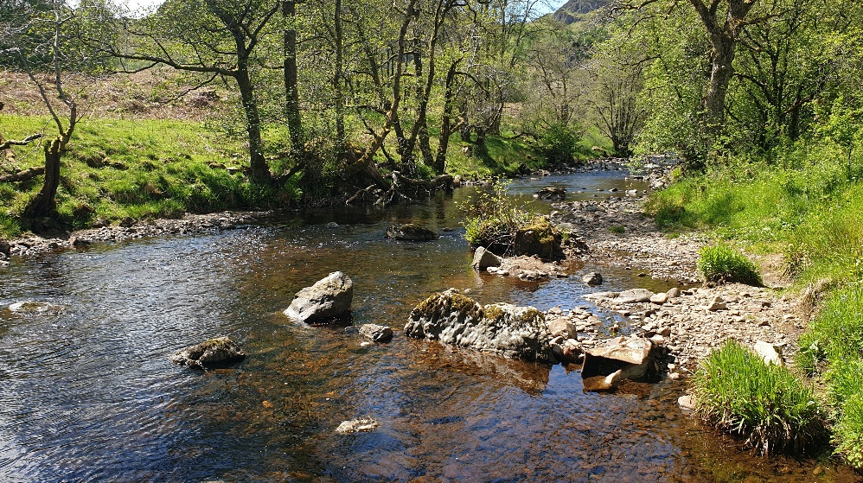
Activity 1 Stop and Think, Spot the Dangers
You and two friends are taking your dog on a walk
by the river
It’s important to Stop and Think, Spot the Dangers
when you’re near water.
Can you see any dangers in this picture?
What dangers might be hidden?
It’s important to identify where you are and if there is rescue equipment near you. How could you get help if you got into trouble here?
What kind of dangers would you find at the coast that you wouldn’t find at inland waters?
Notes:
Introduce the first step in the Water Safety Scotland Code: Stop and Think, Spot the Dangers. You and two friends are taking your do on a walk by the river.
Its important to Stop and Think, Spot the Dangers when you’re near water.
Can you see any dangers in this picture?
What dangers might be hidden?
It’s important to identify where you are and if there is rescue equipment near you. How could you get help if you got into trouble here?
Refer to icons at bottom of the screen the underline the core dangers (the water is colder, deeper, more powerful than you think, and the edge can be dangerous).
Challenge: what kind of dangers would you find at the coast that you wouldn’t find at inland waters?

Slide 5

Activity 2
Where do accidents happen?
Unfortunately people lose their lives every year in different bodies of water.
All water can be dangerous, can you guess where most accidents happen?
We will go through the cards: hands up if you think the number will be higher,
or hands down for lower (amount of people injured/drowned).
Note: Scotland data only 2017 – 2021, WAID
Notes:
Unfortunately people lose their lives every year in different bodies of water. All water can be dangerous, can you guess where most accidents happen?
Clip through the cards and ask the students to say (thumbs up or down) if they think the location would be more or less dangerous than the previous location. Refer to the icons along the bottom of the slide.

Slide 6
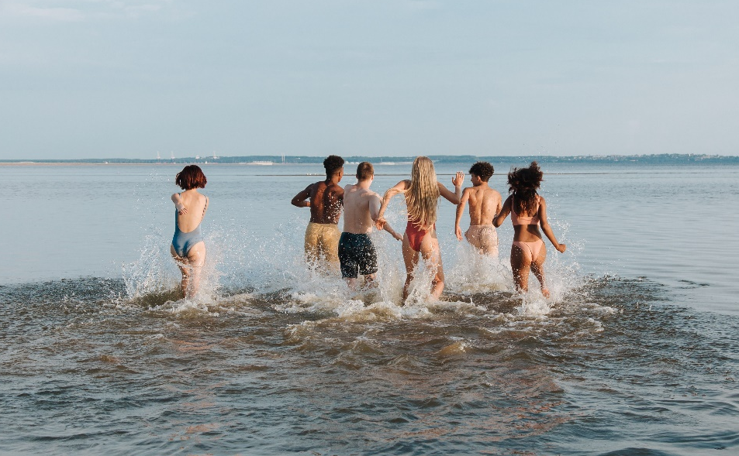

Activity 3 Stay Together, Stay Close
Why are you safer in a group?
Planning for a day out can help you keep safe: what could you bring with you?
Why is it important to look out for others when near water?
Notes:
Introduce the second part of the code, Stay Together, Stay Close. Ask the students to reflect on the following questions:
Why are you safer in a group?
Why is it important to look out for other near water?
Planning for a day out can help you keep safe: what could you bring with you?
Refer to content along the bottom of the slide.

Slide 7
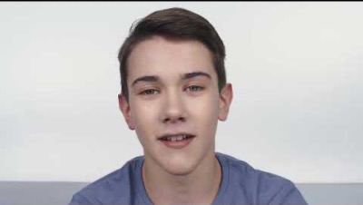


Think about the following questions while
you watch the video…
Why do you think he went into the water?
What would you have done to help him?
Would you have gone into the water?
Why should you never go into the water to help someone?​
What would you do if someone encouraged you to act dangerously near water?
Notes:
Introduce the third part of the code: In an Emergency, Call 999. Please note that whilst this video is not based on a true story, unfortunately situations such as this have occurred. Read aloud the questions prior to playing the video, then discuss the questions.
Why do you think he went into the water?
Would you have gone into the water?
What would you have done to help him?
Challenge: Why should you never go into the water to help someone?
What would you do if someone encourage you to act dangerously near water?

Slide 8
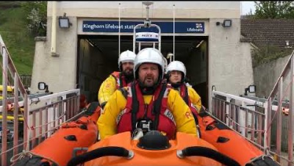
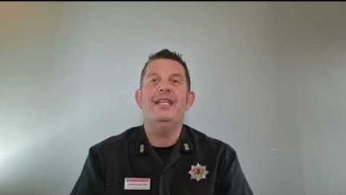
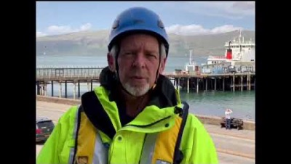
Activity 4
What to do if you see someone in trouble in the water
We respond
in an emergency:
Listen to the clips for information on what action you need to take in an emergency situation
Remember to:
Call 999
Calmly describe where you are and what has happened
Never enter the water
Keep an eye on the person in the water
Notes:
The following emergency services respond in an emergency. Listen to the clips for information on what action you need to take in an emergency situation.
Remember to:
Call 999.
Calmly describe where are and what has happened.
Never enter the water.
Keep an eye on the person in the water.

Slide 9
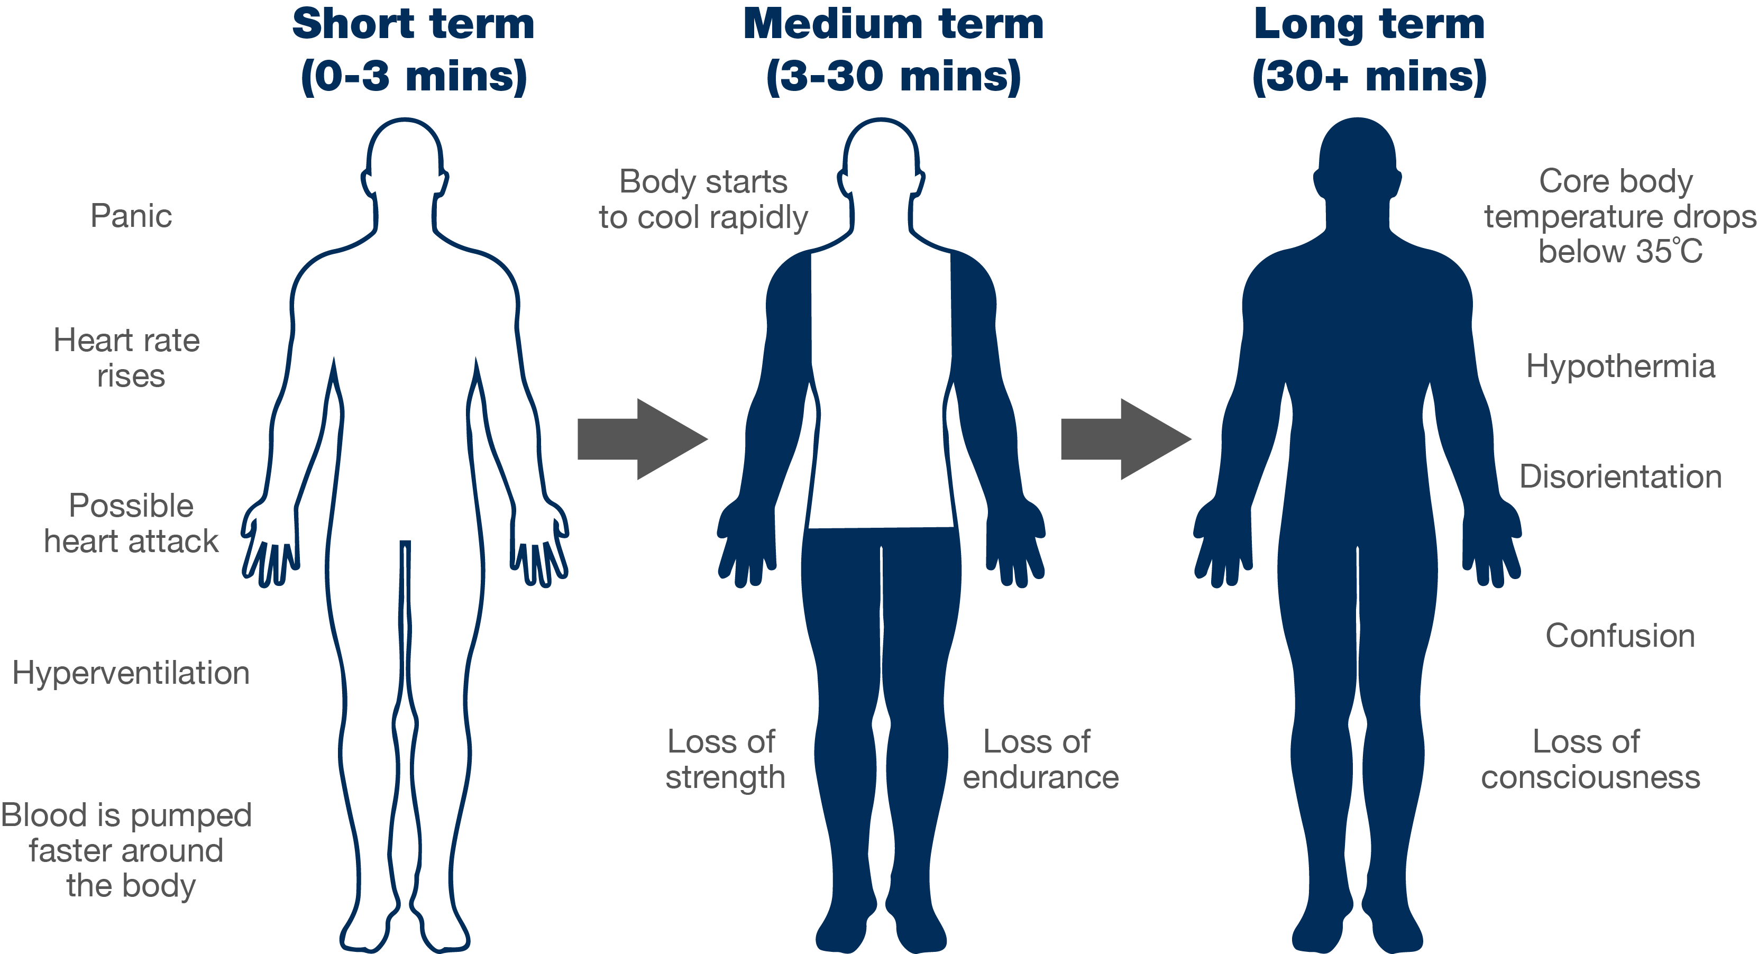
Cold water shock
Notes:
This slide demonstrates how cold water shock affects your body at various stages.
Challenge questions
Is anyone surprised by this order?
What would you do to calm yourself down?
How could calming down increase your chance of survival?
How could floating save your life?
Anything below 15°C is defined as cold water and can seriously affect your breathing and movement, so the risk is significant most of the year.
The average temperature of the sea around the UK and Ireland is about 12°C.

Slide 10
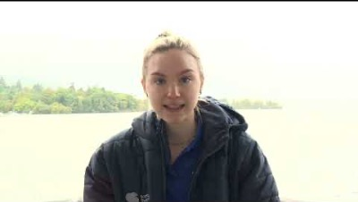




What should you do if you get into trouble in the water?
Cold water shock with Paralympic Athlete Toni Shaw
How would you react?
Key points:
Call 999 if you have a mobile on you
Instead of panicking, Float on your back
After you have calmed down shout loudly for help
If you can – attempt to swim to shore or find something that floats
What emotions might you feel?
How would your body feel?
Notes:
What should you do if you are in difficulty in cold water?
Cold water shock with paralympic athlete Toni Shaw. Play the video to hear Toni Shaw speaking about cold water shock and the float technique.
Read aloud the key points on slide 10.

Slide 11
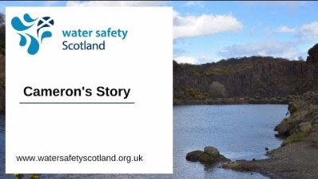
Activity 5
Cameron’s story
We recommend that this should not be viewed by those under the age of 16.
Notes:
Cameron’s Story: Please note that this video is advised for audiences over the age of 16, due to the sensitive nature of the content.

Slide 12
Activity 6
Have you learned the Water Safety Code?
Think of that same body of water again.
Not all dangers are visible: think of two that you can’t always see.
What two actions should you take if you saw someone in trouble in the water?
What should you do if you found yourself in water unexpectedly?
How would you challenge dangerous behaviour you see?
Notes:
Think of the same body of water again (that was discussed during the starter activity).
Read aloud the questions on slide 12 and ask for feedback from the students.

Slide 13
Notes:
Summarise the Water Safety Scotland code.
If appropriate and have time, ask pupils:
Why should you never attempt to enter the water to help someone?
Who do you call in an emergency?
Who do you ask for when at the beach? At a loch?
Which three things can you do to stay safe near water?
Why can some dangers be hidden?
If you fall into cold water, what should you do?
Which three pieces of advice would you give someone about water safety? Should these bullets be in the PowerPoint slide, in the Notes?

Slide 14

This resource is based on the hard work of Gillian Barclay and the Fife Water Safety Group
Notes:
This resource is based on the hard work of Gillian Barclay and the Fife Water Safety Group.

